Slide 1
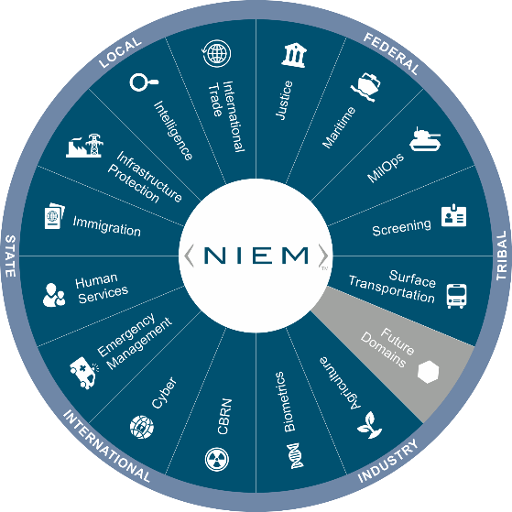
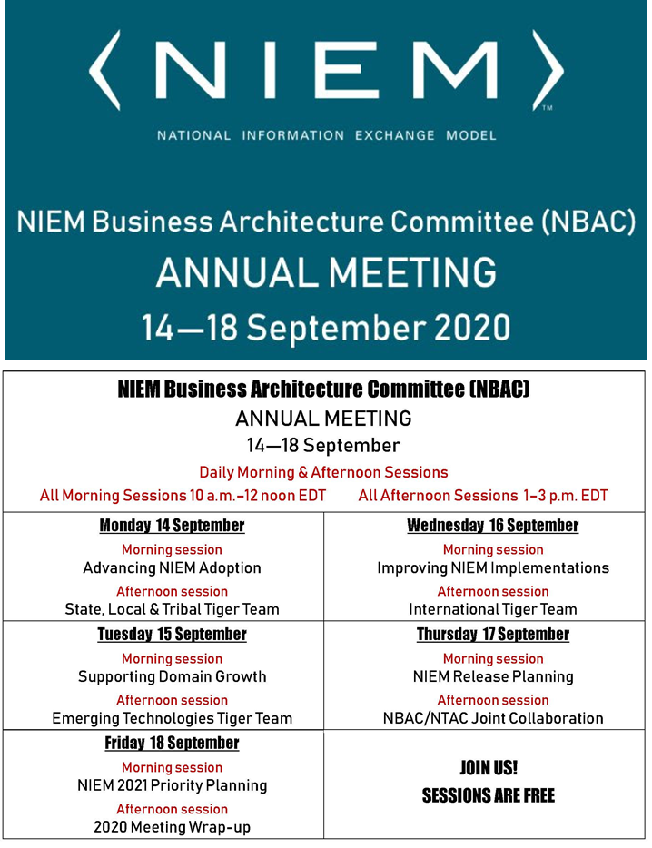


Virtual Annual Meeting (NBAC)
16 September 2020 → 1-3PM
International Tiger Team
Thomas Krul
NBAC Co-Chair
Enterprise Architect,
Public Safety Canada
Thomas.krul@Canada.ca

Slide 2
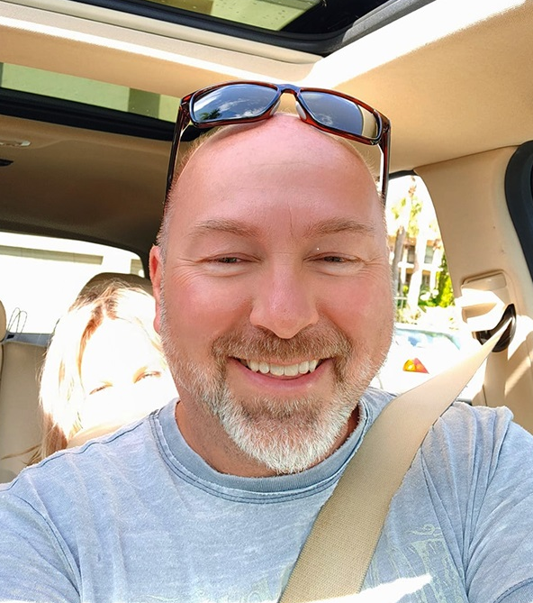

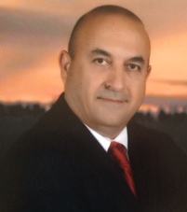

Housekeeping
Speakers
  Primary Facilitator
    Thomas Krul
  Support Facilitator
    Kamran Atri
  Guest Speaker
    Poewen Lau
    Department of
    National Defense
Session:
  International Tiger Team
Keep in mind:
  Sessions will be recorded and may be used for training and communications purposes.
  Ask questions in chat anytime
    To pose a question by voice, “Raise Your Hand” & wait for the facilitator to call on you
  This session briefings available on Github for download
  TBD
2

Slide 3
Session Agenda
Introduction
Guest Speaker: Poewan Lau
Background
Defining Internationalization
Data Model Management
Translation efforts, outreach
Tiger Team and Canada updates

Slide 4
Introducing Guest Speaker
Poewan Lau
Department of National Defense
Enabling System-to-System (S2S) Information Sharing

Slide 5
Background
The NBAC International Tiger Team launched in late 2016 with an overarching goal of expanding the utility of NIEM Program to a larger global audience.
Design concepts, governance, training, and impacts on model architecture and engineering

Slide 6
Defining internationalization
"Going Global" - wrap our arms around the different moving parts
5 eyes for immigration - passport offices
Long handshake between Canada and UK
Japan using it for Olympics
NIEM and NATO NCDF
INTERPOL
Organizing efforts around how Internationalizing NIEM looks

Slide 7
Data model management
The earliest and still central priority of the tiger team was the review and alignment of both Core and Domain data models with a more International Program focus. This will continue with the identification and review of existing, new or emerging data sets, exchange models, IEPDs or other attribute sources that may yield new, unique attributes that support international exchange.

Slide 8
Data model management
Refinements to US-centric terms/definitions in Core
Not all issues are related to language!
Each new release has inputs to both core and domain models
XML Lang 5.0 schema update
Webb Roberts will present

Slide 9
Localization
Localization - NIEM data model
Local terminology and jargon
Local terms for component names and definitions
Language localization on tools
Ongoing maintenance

Slide 10
localization
Governance body for Core
Governance body for Domains
Governance body for Languages?

Slide 11
Outreach
Using English as “go-forward” position
Countries are responsible for translation
NIEM support these bodies
Translations for some components, web content, training

Slide 12
Tiger team activities
Biometrics and Emergency Management domains being extracted via UML modeling tool, translated, evaluated by subject matter experts
Processes used by Canadian NIEM-enabled services being documented for best practice(s)
Ongoing discussions regarding use cases and how to best use internationalized versions of NIEM
Bringing forward issues

Slide 13
Canadian adoption
Many Canadian departments have adopted NIEM in other domains, including CSC, CBSA, RCMP, ESDC, etc.
Employment and Social Development Canada extensively using NIEM
Other Departments are using or are considering using NIEM as well
The Enterprise Data Community of Practice approaches Interoperability from a technology standpoint (e.g., NIEM, Reference Data Standards, etc.)
Working with the Enterprise Data Community of Practice to make NIEM Government of Canada-wide (standardize use)

Slide 14
What you can do to help internationalization niem
We would like to know if there are any international groups that share (or could share) information within your domain.
Are you aware of any services provided by US Gov provide information in a language of choice other than English (or would like to)?

Slide 15


Slide 16
Closing Remarks
16

Slide 17
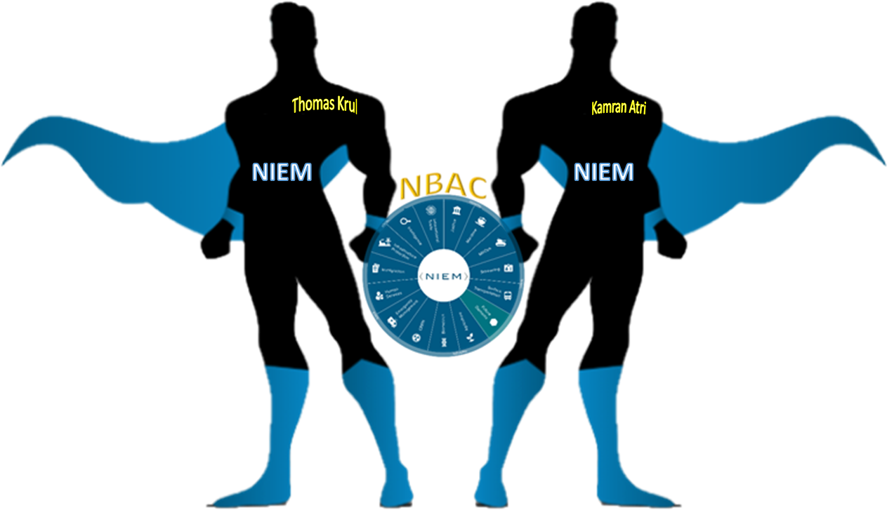
Enabling Connected Future Now
NBAC Co-Chairs
  Thomas Krul
  Kamran Atri
thomas.krul@canada.ca
katri@A4SAFE.COM
17

Slide 18
Annual Meeting Overview
(14-18 September)
NBAC Session | Event Date/ Time | Topic | Primary Facilitator (s) | Support Facilitator (s) | Guest Speaker (s)
1 | Monday, 14 SEP 10 - 12 AM | Advance NIEM Adoption | Kamran Atri | Thomas Krul | Kshmendra Paul
2 | Monday, 14 SEP 1 - 3 PM | State, Local, Tribal Tiger Team | Cait Ryan / Tom Carlson | Thomas Krul | Eric Sweden (NASCIO)
3 | Tuesday, 15 SEP 10 - 12 AM | Support Domain Growth | Kamran Atri | Thomas Krul | Brian Gattoni (DHS CISA CTO)
4 | Tuesday, 15 SEP 1 - 3 PM | Emerging Technologies Tiger Team | Jalal Mapar | Lain McNeill | Syed Mohammed
5 | Wednesday, 16 SEP 10 - 12 AM | Improve NIEM Implementation | Thomas Krul | Kamran Atri | Dr. Paul Flynn (JNKE)
6 | Wednesday, 16 SEP 1- 3 PM | International Tiger Team | Thomas Krul | Kamran Atri | Poewan Lau
7 | Thursday, 17 SEP 10 - 12 AM | NIEM Release Planning | Christina Medlin | TBD | N/A - Working Session
8 | Thursday, 17 SEP 1- 3 PM | NBAC/NTAC Collaboration Planning | Kamran Atri/ Web Roberts | Thomas Krul/ Dr. Scott Renner | N/A - Working Session
9 | Friday, 18 SEP 10 - 12 AM | NIEM 2021 Priority Planning | Katherine Esobar | Stephen Sullivan | Stuart Whitehead
10 | Friday, 18 SEP 12 -12:15 PM | WRAP-UP/Adjourn | Kamran Atri / Thomas Krul | Stephen Sullivan | N/A

